Slide 1
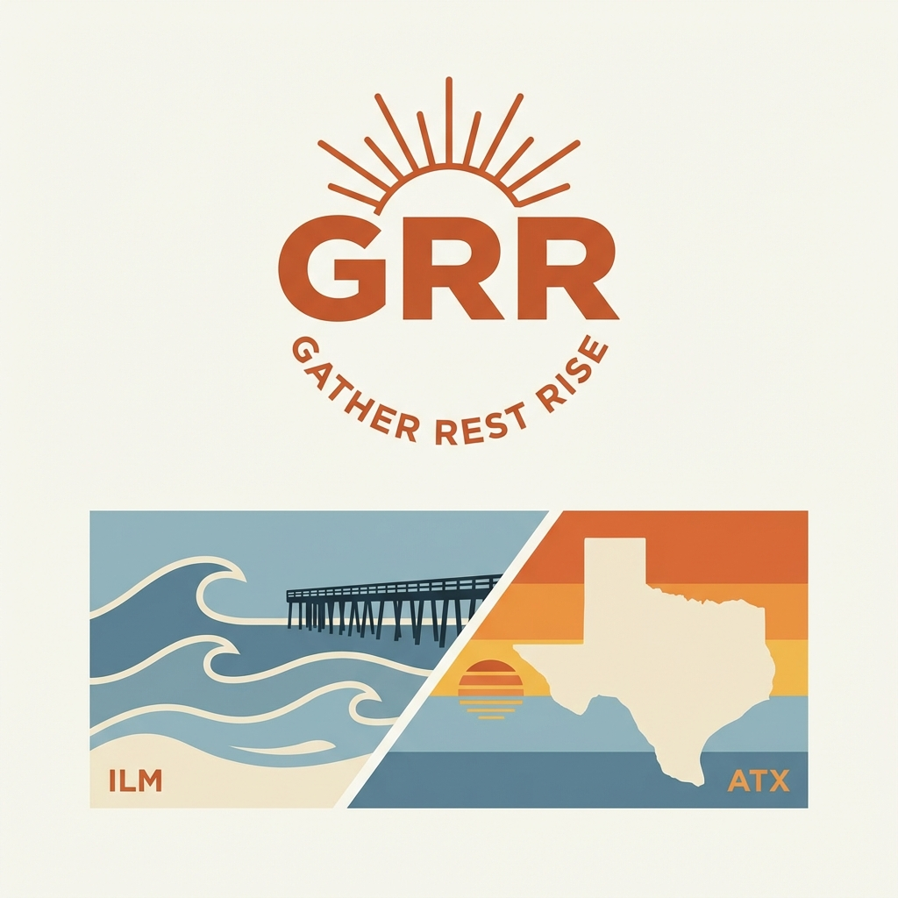

Slide 2
The Brand Story
Two places shaped us: Wilmington, NC Early morning paddle-outs. Sunset dinners on the porch with family. Austin, TX Dawn gym sessions. Building something meaningful. Home for dinner with the people who matter. For those who refuse to choose. Crush your goals AND be present.
Fitness fuels. Rest sharpens. Family grounds.

Slide 3
What GRR Means
GATHER
REST
RISE
Bring together what matters most.
Family. Friends. Community.
This is your fuel.
Recovery isn't weakness.
It's strategy.
Your best work comes after intentional rest.
Show up stronger.
Every single day.
In the gym. At work. For your family.

Slide 4
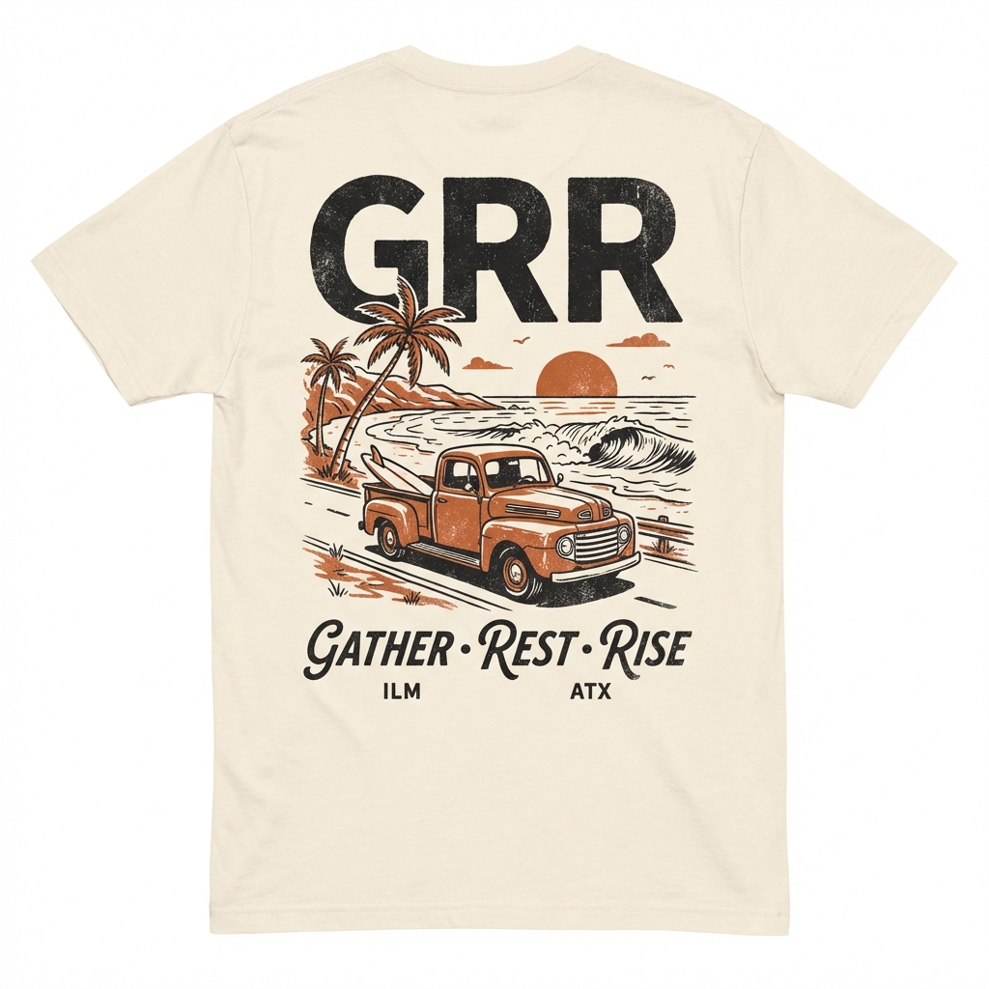
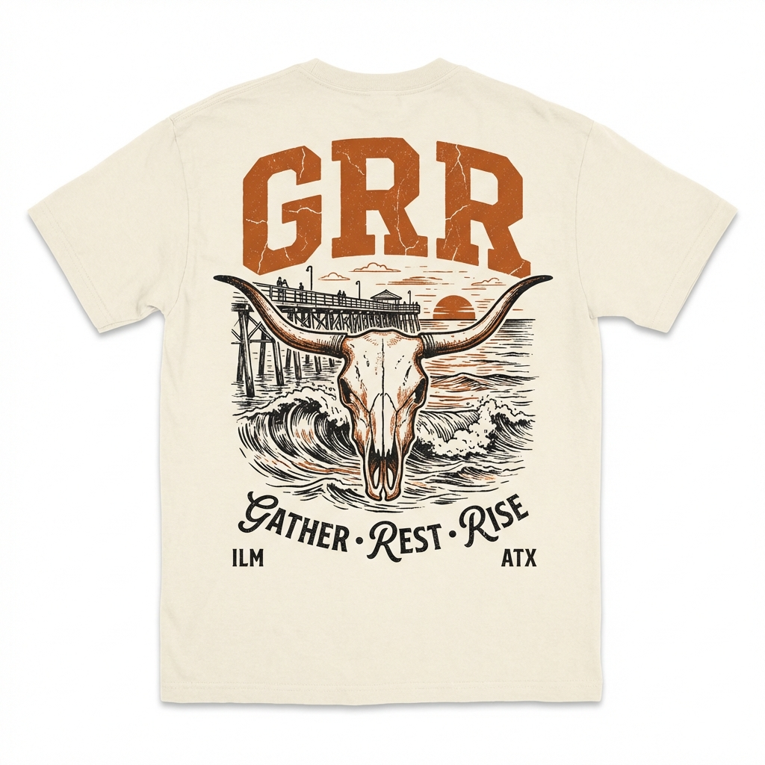
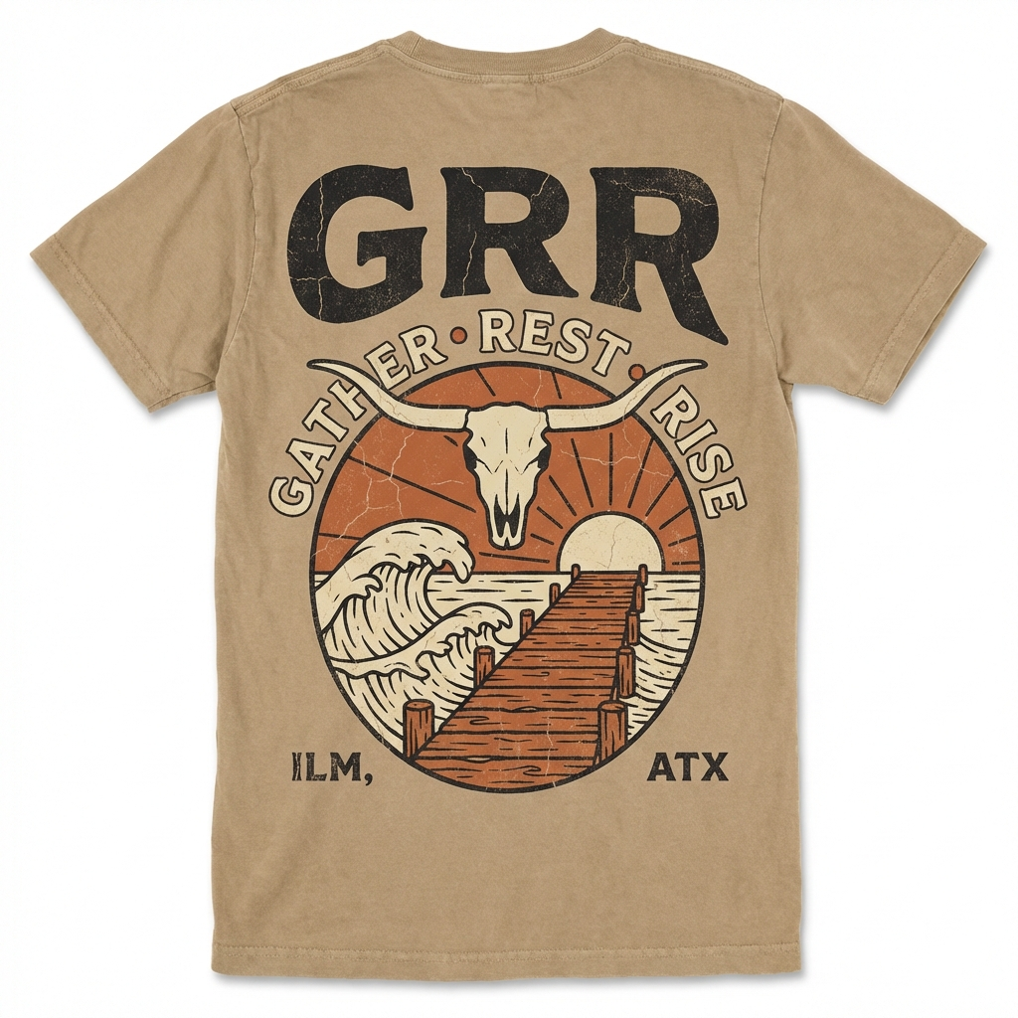
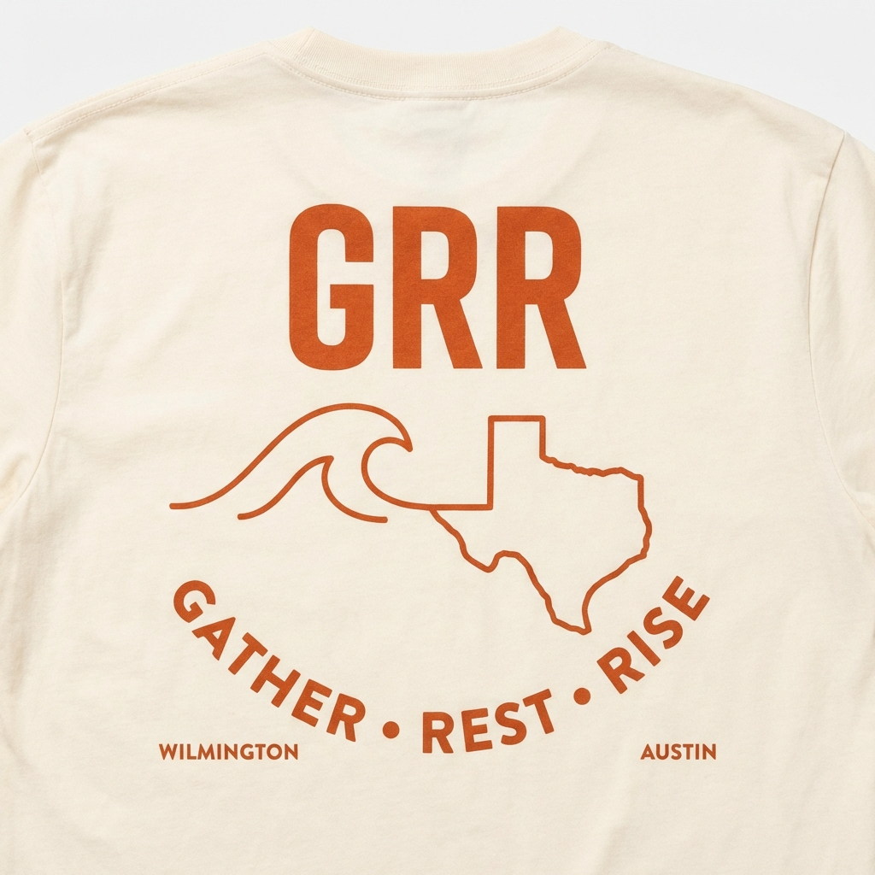
The Collection
Premium T-Shirts — $45 | 100% Cotton | Made to Last
Beach Truck
Longhorn Pier
Vintage Skull
Wave + Texas
ILM × ATX — Two roots, one identity

Slide 5
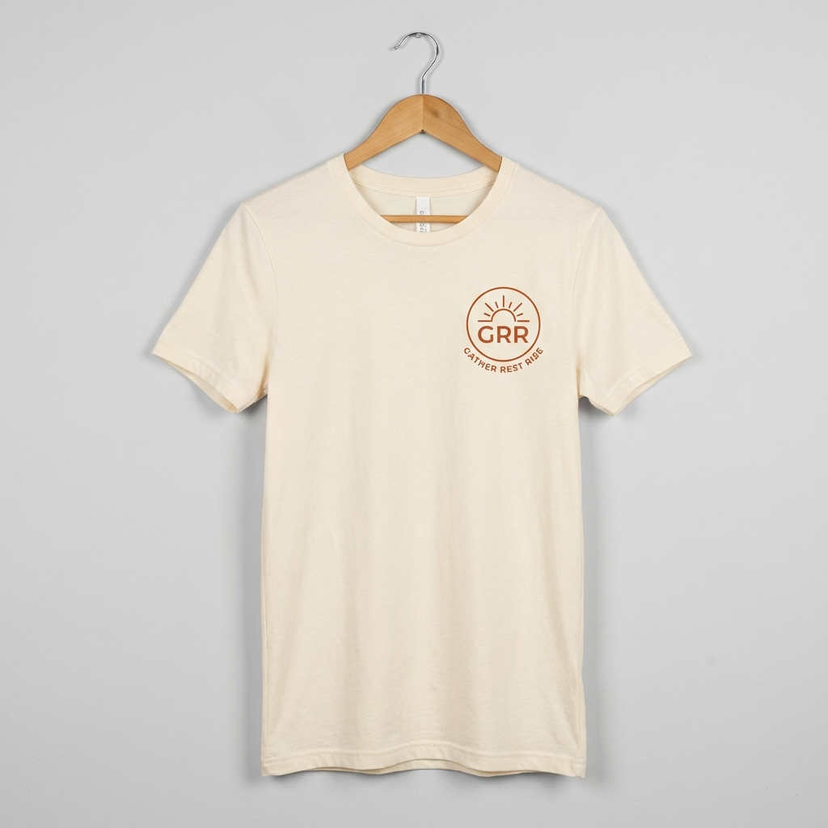
Design 1: Beach Truck
Vintage soul meets coastal freedom
FRONT
BACK

Slide 6
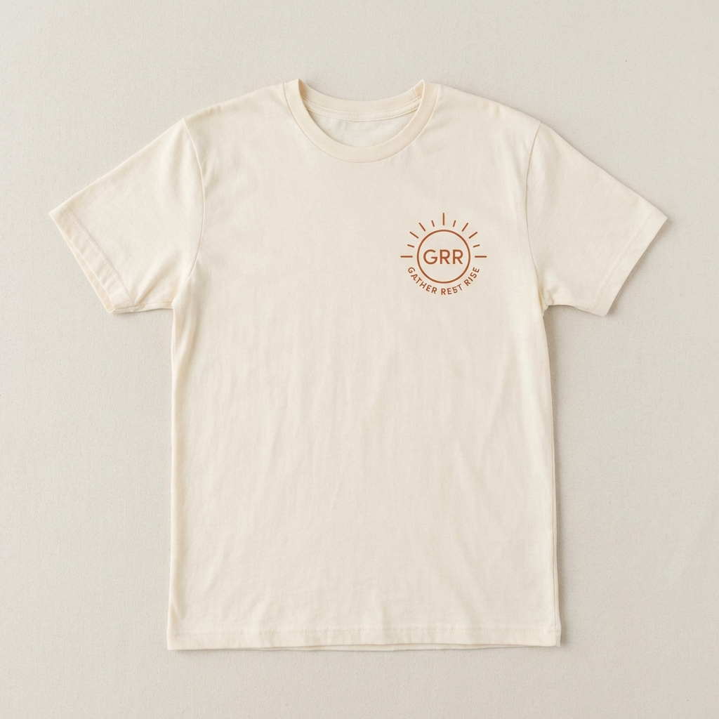
Design 2: Longhorn Pier
Where Texas pride meets ocean tide
FRONT
BACK

Slide 7
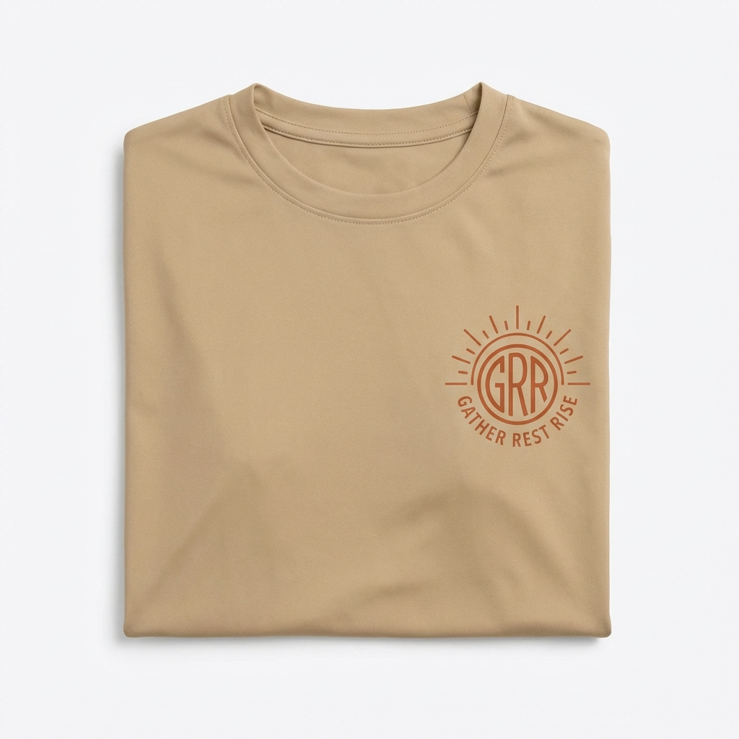
Design 3: Vintage Skull
Heritage. Grit. Timeless style.
FRONT
BACK

Slide 8
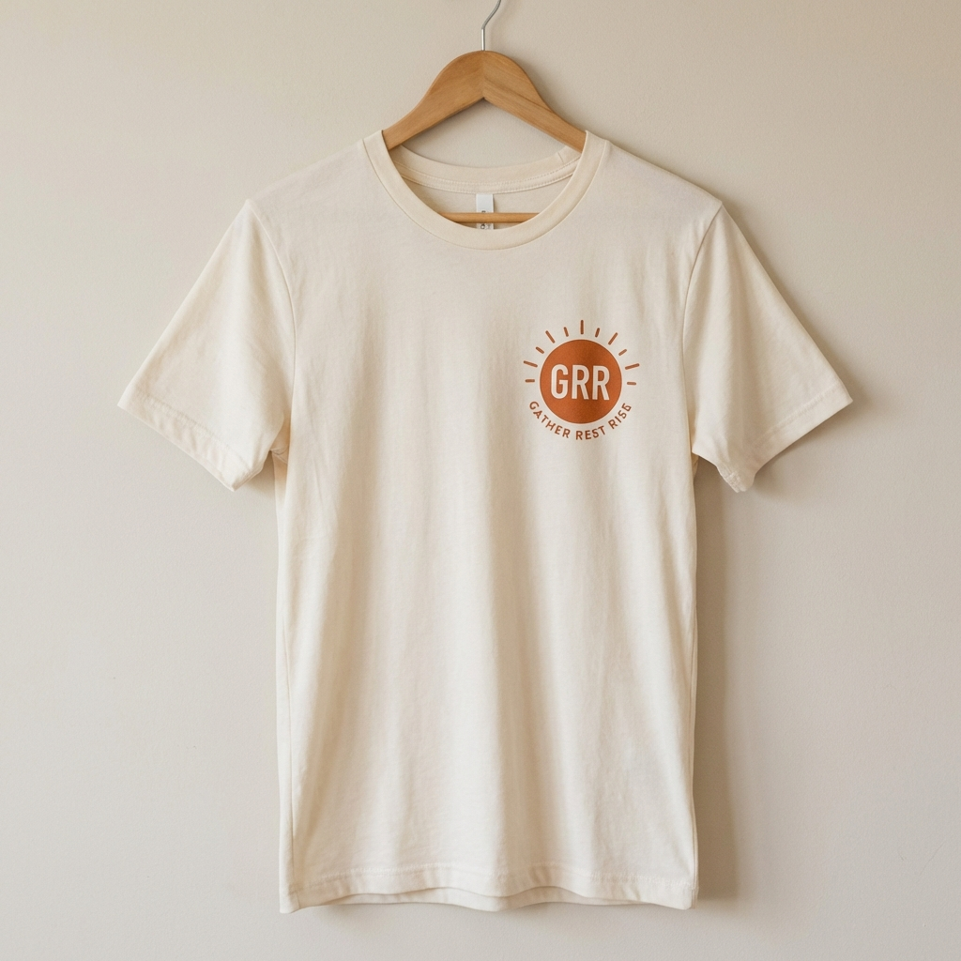
Design 4: Wave + Texas
Clean lines. Bold roots.
FRONT
BACK

Slide 9
Who We Serve
The Active Parent
Early gym sessions before the house wakes up. Quality time matters as much as quality reps.
The Coastal Texan
Beach roots, Texas pride. Fewer things, better things. Authenticity over trends.
The Balanced Builder
Building a career AND a life. Burnout isn't a badge. Success includes health and family.

Slide 10
Let's Build This Together
Premium lifestyle apparel for those who
work hard, stay fit, and put family first.
Gather. Rest. Rise.
ILM × ATX

